Slide 1
Starter
Complete the following ;
  Topic 6– worksheet

Slide 2
Topic 24
Health, Safety & Other Issues

Slide 3
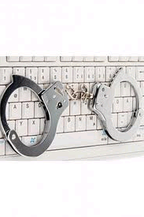
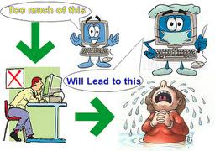
Health & safety
Laws relating to the use of ICT
Ways in which you can keep data safe
Ways in which you can keep yourself safe when online
Health problems that may affect you when using ICT systems

Slide 4
Copyright Law
Anything that has been produced by someone, that is based on their own ideas can be subject to copyright laws in this country
If you have copyright on something it literally means you are the only one that is allowed to copy it
This relates to music, books, images, films, software etc.
If you want to copy someone else’s work, then you have to ask permission
You will usually have to pay for this
The most common form of breaking copyright laws is the copying of CD’s, DVD’s and computer games

Slide 5
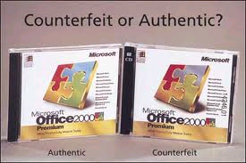
Software Piracy
The Copyright, Designs and Patents Act 1989 makes software piracy illegal
Software piracy is very common but difficult to detect and even harder to prove
Some software requires a licence number
Some companies buy site licences, this means they can run a given number of the program on their computers

Slide 6

Accidental Damage to Files
It is very easy to accidentally destroy data
It is important to have a backup strategy
This is an exact copy of the data that is stored somewhere different from the original
If a disaster happens then the back-up copy can be used instead
In large companies back-ups are taken at the end of each day, and stored off site
You can make files “read-only”, this means that the file cannot be accidentally changed or deleted

Slide 7
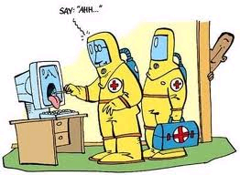
Viruses
Data needs protecting from malicious damage, that is deliberately caused
Most common source for this is viruses
A virus is a computer program that can;
  Copy itself from one computer file to another
  Attach itself to an email so that it can spread from one computer to another
Cause damage to files stored on a computers hard disk
All viruses have different names, they can spread across the world in just a few days
They can be called either worms or Trojans

Slide 8
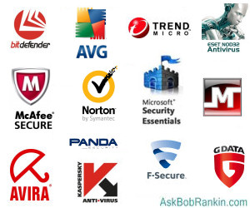
Anti-Virus software
Anti-virus software is special software that protects computer files
It detects and tries to remove the threat
The software checks all drives, including pen drives that are attached to your computer
It must be kept up to date
Some precautions to prevent infections by virus are;
  Do not use a memory stick on one computer then another unless you know that the anti virus software is running and up to date
  Don’t open emails from people you don’t know, especially attachments
  Don’t download unless its from a trusted website
  Run virus checks frequently
  Update you anti virus definitions if they don’t automatically update
  Take regular backups

Slide 9
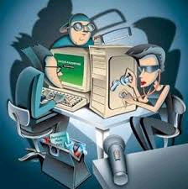

Hacking
A hacker is someone who deliberately accesses data stored on a computer without authorisation
Hacking is a global problem
Hackers may change data to their advantage or delete or damage it
Hackers may gain data for criminal purposes such as blackmail
Banks are frequent targets
It can be difficult to know how much hacking is happening (banks don’t like to admit to any failures in their security systems)
Organisations try to stay one step ahead of the hackers, devising more sophisticated measures of preventing them from accessing their files
Hackers may communicate with each other to help each other get past new security measures
The computer hackers and phishing experts 'on our side'

Slide 10

Protect a Network from Hackers
Organisations may;
Use a system of passwords. Each user has their own username and password when logging on. Passwords should;
  Be changed regularly
  Not be obvious
  Not be told to anyone
Users should log off properly when they have finished using their computer
Computers should be shut down properly when not in use
Data should be encrypted when transmitted. This means it is changed so that a hacker can’t understand it or use it
A Firewall should be used to prevent hackers from accessing a network. It is a piece of software that is usually included when you buy virus-protection software

Slide 11
Staying Safe Online
SMART rules for staying safe online developed by Kidsmart
Safe – don’t give out your personal information (name, email, phone number, address, school name to people you have met online
Meeting – this can be dangerous if you have only met online. Only meet with your parents/carers permission or when they can be there
Accepting – accepting emails/messages or opening files, pictures or texts from people you don’t know is not a good idea…it could contain a virus or nasty message
Reliable – people may not be who they say they are, information on the Internet may not always be reliable
Tell – if someone or something online makes you feel uncomfortable tell your parent, carer or trusted adult. You can report abuse online to the police or at www.thinkuknow.co.uk

Slide 12
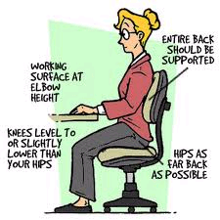
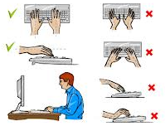
Health & Computers
A number of health issues when using computers for a long period of time
Ergonomics (study of the worker & the environment). Consideration must be given to the design of the chair, desk, computer, telephone & other equipment to increase efficiency and avoid fatigue or health problems

Slide 13
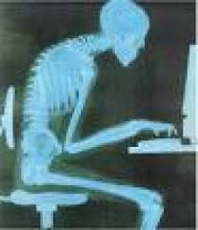
Health Issues
Back or neck strain
These may include;
Back or neck strain; using badly positioned desk, chair and computer for long periods of time
Help may include;
  Chairs should be adjustable, set at the correct height with forearms being horizontal
  You should take frequent breaks and walk around
  You should use a footrest

Slide 14

Health Issues
Eye Strain
Eye strain; poor quality monitors, poor lighting and long hours spent looking at a computer screen may lead to eye problems
help may include;
  Computer screens should be set at the correct distance (arms length away)
  Monitors should not flicker or be too bright. They should swivel and be positioned at the correct angle
  Blinds should be used to minimise glare from the sun and reflection on the screen
  Regular breaks should be taken

Slide 15
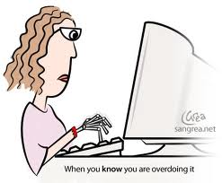
Health Issues
Repetitive Strain Injury (RSI)
Repetitive Strain Injury (RSI); constant use of the joints in the fingers, hands or wrists may lead to long term pain or stiffness in the tendons. This is a common problem for office workers or serious computer games players who spend a long time using a mouse or keyboard. Surgery may be needed to help.
Other help may include;
  Use of rests for wrists and arms
  Take frequent breaks from typing or using a mouse
  Perform hand and wrist exercises regularly
  Relax. Grip the mouse lightly (tension may cause RSI)
  Position the mouse & keyboard at the correct height & distance, make sure you are sitting comfortably

Slide 16
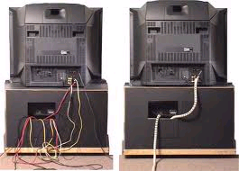
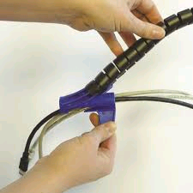
Safety & Computers
Computers & peripherals are often heavy, and computer rooms full of electrical sockets & wires which could all be safety hazards
Trailing wires can be tripped over or caught, so pulling heavy equipment off shelves – wires should be kept cleared away or placed in “cable tidies”
Risk of fire or electrocution from bare or worn wires, or from badly wired plugs – plugs & wires should regularly be checked by a qualified person

Slide 17
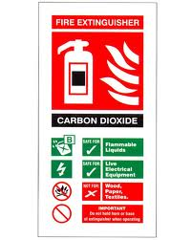
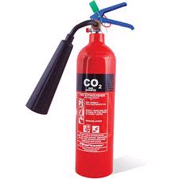
Safety & Computers
Unsecured equipment such as monitors or speakers may fall - shelves should be firmly fixed, and the equipment secure
Food & drink should not be near computers – crumbs can enter the keyboard and cause sticking keys or disease. Liquids can cause electrocution and damage equipment
Fire extinguishers must be powder or carbon dioxide type

Slide 18
Activity
Open the Folens Interactive Resources
Complete the following;
Topic 24 Interactive Activity 1
Topic 24 Interactive Activity 2

Slide 19
Homework
Complete the following for homework ;
Topic 24 – Multiple choice questions

Slide 20
Exam Practice questions
Explain what a computer virus is and how you can protect a computer against a virus (3)
Explain what hacking is and how you can protect a computer against it (3)
Describe three health problems that can occur when using a computer for long a long period of time and describe ways of preventing those problems (6)
Describe three safety problems that can occur in a computer room and describe ways of preventing the problems (6)
Explain what is meant by the copyright laws and why it is necessary to have these laws(4)
Explain and write down points of advice on how to stay safe online when using social networks (6)

